Slide 1
Relational Model

Slide 2
Relational Data Models
The relational data model consists of three major components:
Data structures - Data are organised in the form of tables with rows and columns.
Data manipulation - Powerful operations (e.g. SQL) are used to manipulate data stored in the relations
Data integrity - relation integrity rules to maintain the integrity of data.

Slide 3
Relational Data Structures
Domain
  A domain is a set of values all of the same data type. For example, the domain of product price is the set of all currency values. A domain should contain values that are in their atomic state and cannot be decomposed further.
Relations
  A relation is a named, two-dimensional table of a set of named columns and unnamed rows. Each row of the relation is uniquely identified. The order of columns and rows is insignificant.
Relational database
  A relational database is a collocation of relations or tables. Tables are linked by common columns drawn on the same domain.

Slide 4
Relational DB Language
Data Definition Language (DDL):
Used to define the database schema - structure of the relational model.
  A language that allows the creation and description of tables (relations) and their relationships within a database.
  Result of compilation of the DDL statements is a set of relations stored in special files collectively called the system catalog or sometimes referred to as the data dictionary.
Data Manipulation Language (DML):
Used to manipulation data in the database – manipulation of the relational model.
  A language that provides a set of operations (insert, update, retrieve and delete) to support the basic data manipulation on the data.

Slide 5
Relational Data Integrity
Relational data integrity is concerned with three aspects of the data in a database: accuracy, correctness, and validity.
Relational Integrity is enforced via integrity rules.
There are three main types of integrity specified in the relational model:
    Domain integrity
    Entity integrity
    Referential integrity
These integrity rules can be specified and implemented by appropriate SQL statements.

Slide 6
Domain Integrity
It is concerned with the values that may be contained within a particular attribute column.
The domain integrity rule states that:
Every attribute is required to satisfy the constraint that its values are drawn from the relevant domain.
Question:
How to implement domain integrity in SQL?
All of the values that appear in a column of a relation must be drawn from the same domain.

Slide 7
Entity Integrity
The entity integrity rule is designed to assure that
every relation has a primary key
the data values for that primary key are all valid
In particular, it guarantees that every primary key attributes is unique and non-null.
All of the values that appear in a column of a relation must be drawn from the same domain.

Slide 8
Referential Integrity
It is concerned with foreign keys.
The referential integrity rule states that
  The database must not contain any unmatched foreign key values.
A foreign key F1 in a relation R1 which matches the primary key P2 in a relation R2 must either:
  a) be equal to the value of P2 in one tuple of R2
All of the values that appear in a column of a relation must be drawn from the same domain.
match

Slide 9
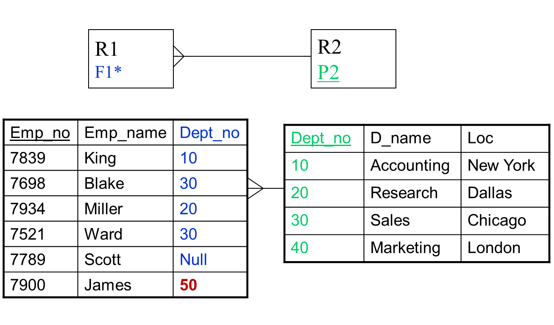
Referential Integrity - Example
All of the values that appear in a column of a relation must be drawn from the same domain.
match

Slide 10
Referential Integrity - Example
It ought to be impossible to delete Dept_no 10 in the Dept table and at the same time leave Dept_no 10 undisturbed in the Emp table.
It ought to be impossible to update a Dept_no value in the Dept tuple (e.g. 30 changed to 60) and at the same time leave the Emp table unchanged.
All of the values that appear in a column of a relation must be drawn from the same domain.
match

Slide 11
Referential Integrity Implementation
The current standard of SQL “SQL/92” has included Referential Integrity Constraints, defined at the data definition stage automatically.
Subsequently, with each insert, update and delete operation, there is a check that the referential integrity rule is not violated.
All of the values that appear in a column of a relation must be drawn from the same domain.
match

Slide 12
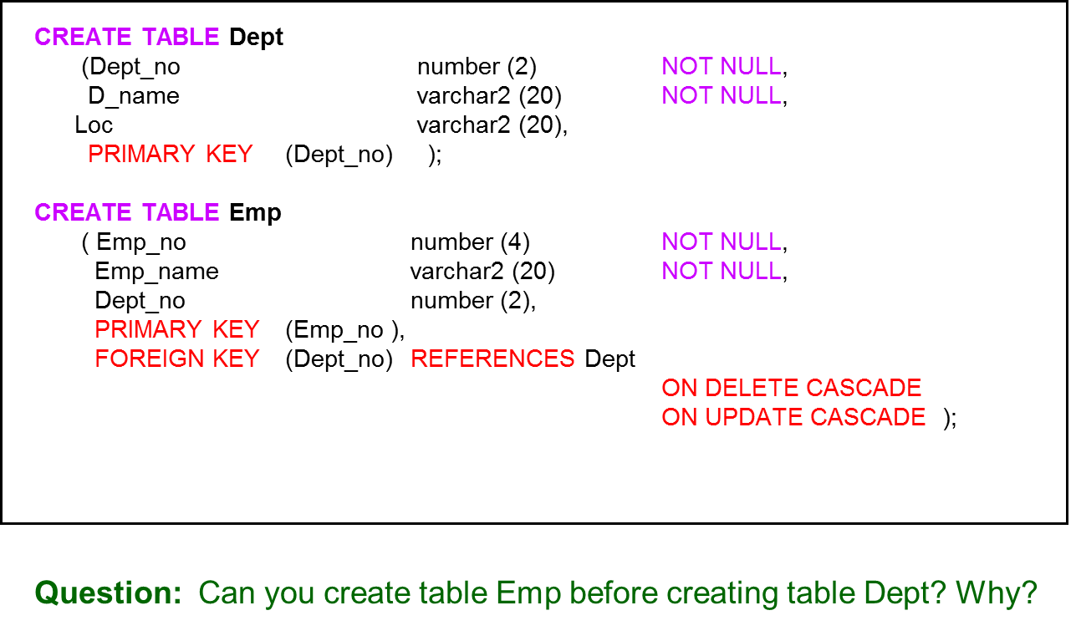
Implementation - Example
All of the values that appear in a column of a relation must be drawn from the same domain.
match

Slide 13
Another Example
CREATE TABLE Sassignment
( StudentNo varchar2 (6) not null,
ModuleCode varchar2 (5) not null,
Grade number(2) Check (Grade >=0 and Grade<=16),
PRIMARY KEY (StudentNo, ModuleCode),
FOREIGN KEY (StudentNo) REFERENCES Student (StudentNo),
FOREIGN KEY (ModuleCode) REFERENCES MAssignment (ModuleCode) );
Domain integrity
Entity integrity
Referential integrity

Slide 14
Foreign Key Definition
A foreign key definition in SQL/92 takes the form
FOREIGN KEY ( attribute(s) )
REFERENCES base-table [ attribute(s) ]
[ ON DELETE option ]
[ ON UPDATE option ]
where option is NO ACTION or CASCADE or SET DEFAULT
or SET NULL.
For each foreign key in the database the following question need to be answered.
  what should happen whenever there is an attempt to delete/update a tuple which is linked by foreign keys to tuples in other tables?

Slide 15
Option: NO ACTION (Restrict)
the default option.
the delete operation is restricted to the case where there is no matching foreign key.
For example, if an attempt is made to delete a department record in the Dept table, it will only be done if there is no matching record in the Emp table.

Slide 16
Option: CASCADE
  the delete operation cascades to delete matching tuples in the other tables.
  For example, if an attempt is made to delete a department record in the Dept table then all the matching records in the Emp table etc will also be deleted.

Slide 17
Option: SET NULL
here the foreign key is set to null in all matching tuples before the tuple in the base table is deleted.
Used only when the foreign key can accept null values (which means the foreign key attribute is not a component of the primary key for that table).

Slide 18
Option: SET DEFAULT
this is an alternative to SET NULL.
the foreign key in the matching tuple is set to some default value such as ‘99999’ to represent missing information.

Slide 19
Option: SET DEFAULT
this is an alternative to SET NULL.
the foreign key in the matching tuple is set to some default value such as ‘99999’ to represent missing information.

Slide 20
User Defined Integrity Rules
Main (general) integrity rules
The above three relational integrity rules
Additional application-specific or user defined integrity rules
There could be (many) additional integrity rules which only apply to a particular application/ database.
Question:
Consider a university student database;- what could be additional integrity rules?

Slide 21
Answer to the question
Question:
Consider a university student database;- what could be additional integrity rules?
Answer:
Possible additional application-specific rules could be:
  no undergraduate student is allowed to take a postgraduate module.
  no module can be taken unless its pre-requisite module has been taken.
  no student can be registered for a module if the maximum capacity of the module has been reached.
  etc.

Slide 22
Summary
Relational model
Relational data integrity

Slide 23
Bibliography
Connolly, T.M. &Begg, C.E., 2009. Database Systems: A Practical Approach to Design, Implementation and Management 5th ed., Addison Wesley. ISBN-0321523067
Date, C. J. 2004. An Introduction to Database Systems (8th ed.), Addison­Wesley, ISBN-0321197844

